Slide 1
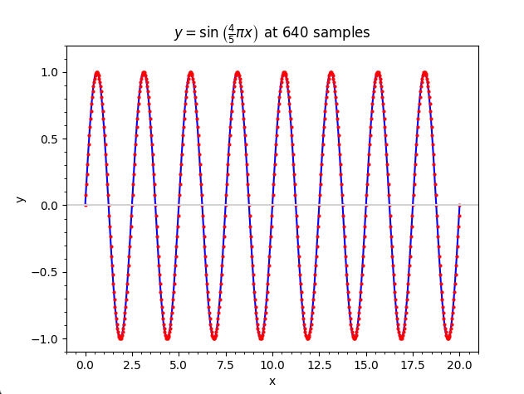
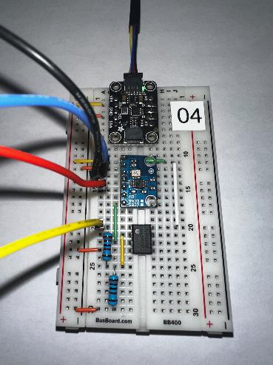
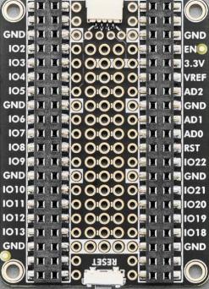
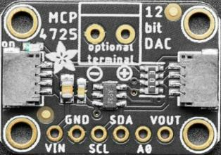
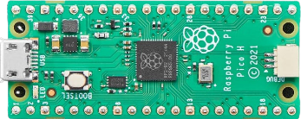
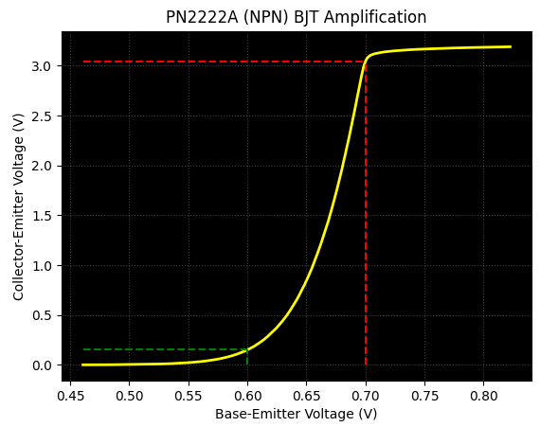

Control System Electronics 101
Using Python and Sensors to Measure Circuits
Topic 01
Fourier Analysis
Dave Biersach
dbiersach@bnl.gov

Slide 2
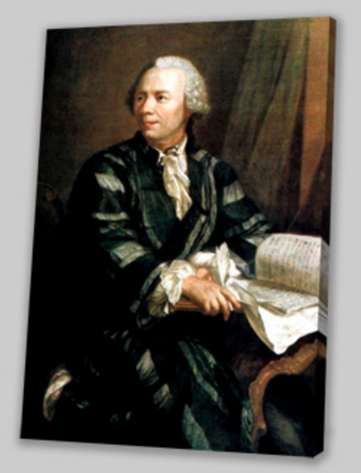
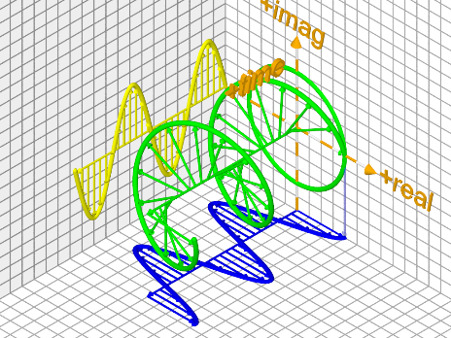
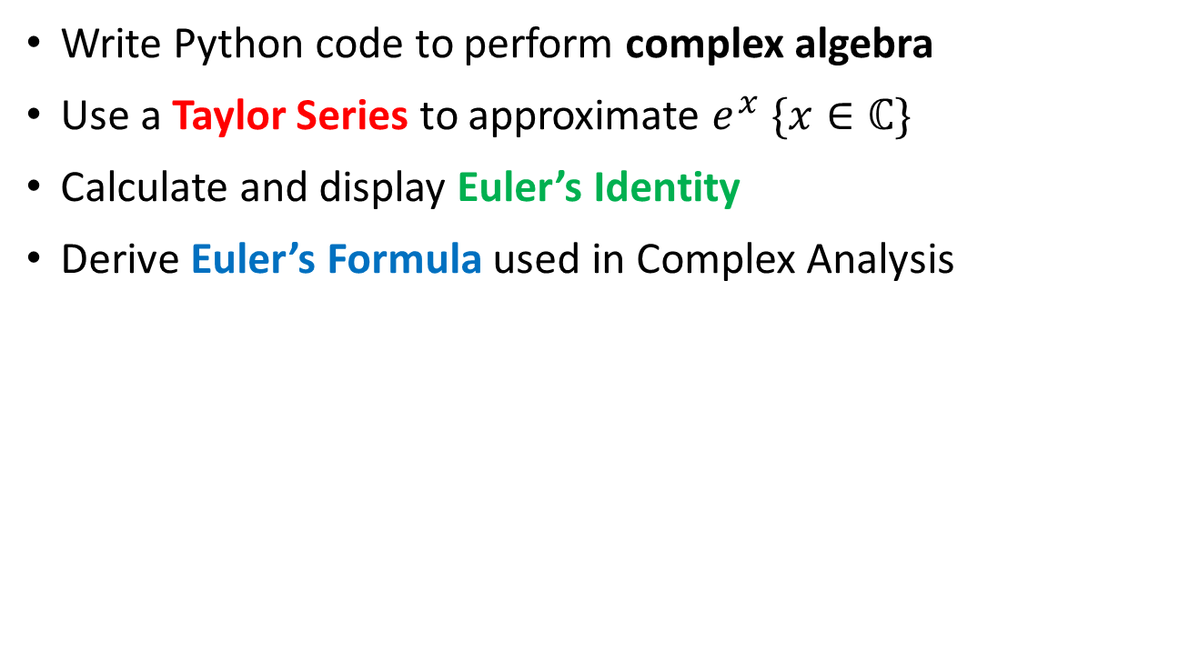
Topic 01 – Goals – Part 1 of 2
Write Python code to perform complex algebra
Use a Taylor Series to approximate $e^{x} \{x∈ℂ\}$
Calculate and display Euler’s Identity
Derive Euler’s Formula used in Complex Analysis

Slide 3
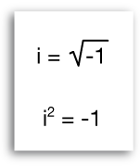
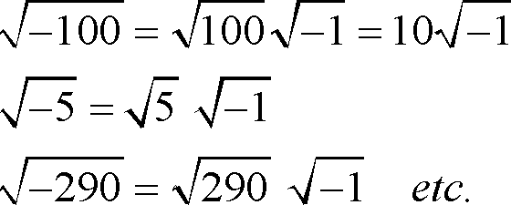
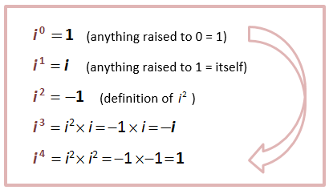
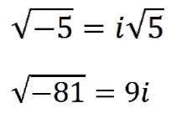
Complex Numbers

Slide 4
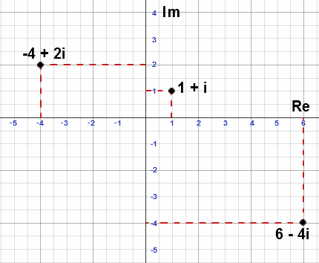
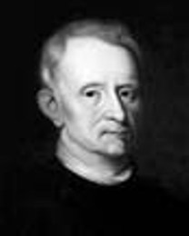
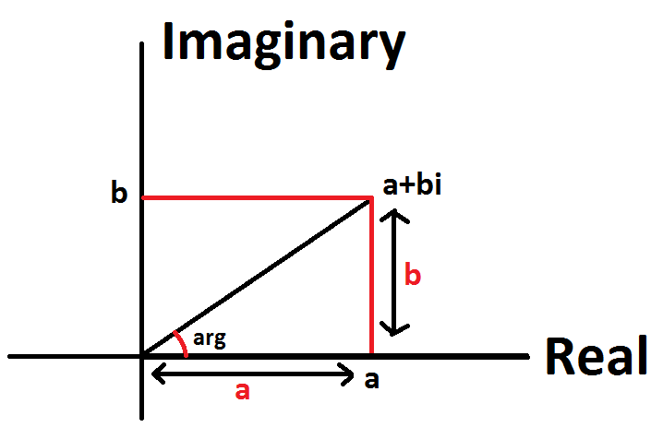
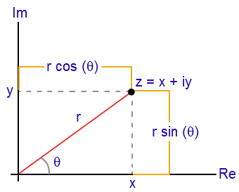
Complex Numbers
Jean-Robert Argand
(1768-1822)
Argand Diagram
Polar Form of Complex Numbers

Slide 5
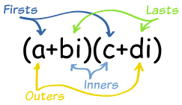
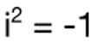
Complex Algebra
Sum:
$$\left(4+3i\right)+\left(5−4i\right)=\left(4+5\right)+\left(3−4\right)i$$
$$=9−i$$
Difference:
$$\left(4+3i\right)−\left(5−4i\right)=\left(4−5\right)+\left(3−\left(−4\right)\right)i$$
$$=−1+7i$$
Product:
$$\left(4+3i\right)\left(5−4i\right)=20−16i+15i−12i^{2}$$
$$=20−i+12$$
$$=32−i$$

Slide 6
Complex Algebra
Division:
$$\frac{\left(4+3i\right)}{\left(5−4i\right)}$$
$$\frac{\left(4+3i\right)}{\left(5−4i\right)}=\frac{\left(4+3i\right)}{\left(5−4i\right)}×\frac{\left(5+4i\right)}{\left(5+4i\right)}=\frac{\left(8+31i\right)}{41}$$
Complex Conjugate
$$=\frac{8}{41}+\frac{31}{41}i$$

Slide 7
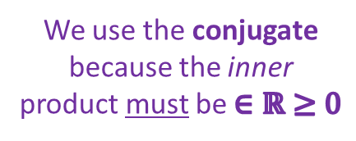
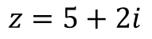
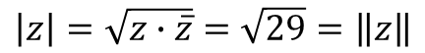
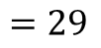
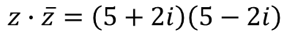
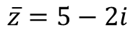
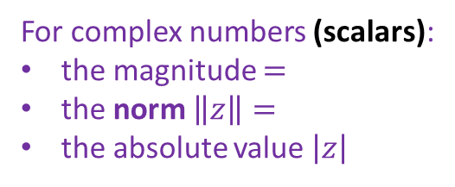
Complex Algebra
$$z=5+2i$$
We use the conjugate because the inner product must be $∈ℝ≥0$
$$\overline{z}=5−2i$$
$$z∙\overline{z}=\left(5+2i\right)\left(5−2i\right)$$
$$=\left(5⋅5\right)+\left(5⋅−2i\right)+\left(2i⋅5\right)+\left(2i⋅−2i\right)$$
$$=29$$
$$\left|z\right|=\sqrt{z∙\overline{z}}=\sqrt{29}=\left\|z\right\|$$
For complex numbers (scalars):
the magnitude $=$
the norm $\left\|z\right\|=$
the absolute value $\left|z\right|$

Slide 8
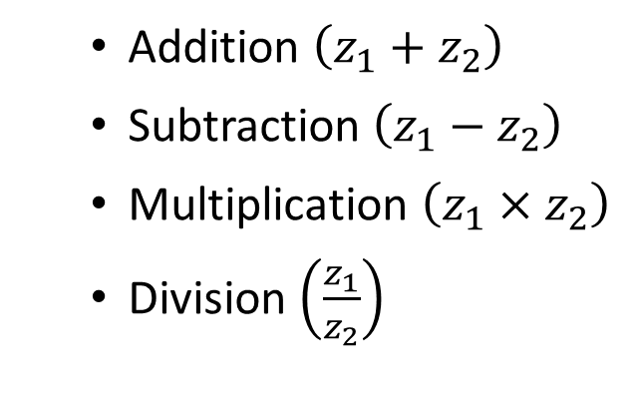
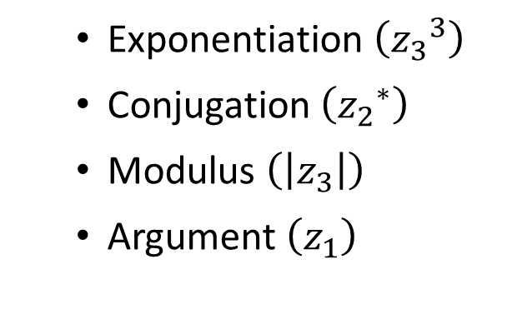
Complex Algebra
Given $z_{1}, z_{2}{,z}_{3}∈ℂ$
write Python code to display:
Addition $\left(z_{1}+z_{2}\right)$
Subtraction $\left(z_{1}−z_{2}\right)$
Multiplication $\left(z_{1}×z_{2}\right)$
Division $\left(\frac{z_{1}}{z_{2}}\right)$
Exponentiation $\left({z_{3}}^{3}\right)$
Conjugation $\left({z_{2}}^{∗}\right)$
Modulus $\left(\left|z_{3}\right|\right)$
Argument $\left(z_{1}\right)$

Slide 9
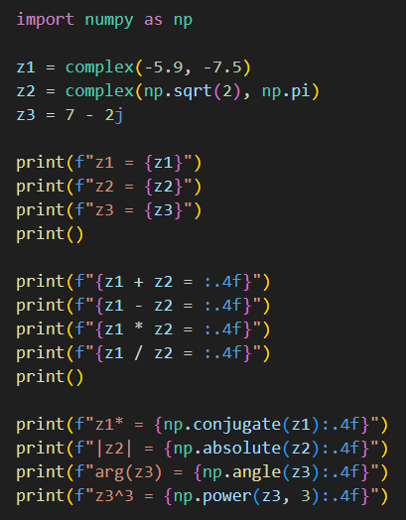
Open complex_algebra.py
①
②
③
④
⑤
⑥
⑦

Slide 10
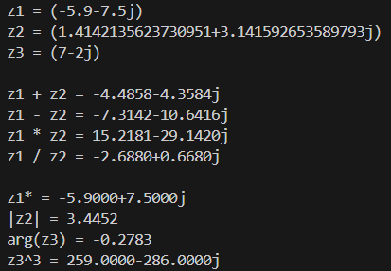
Run complex_algebra.py

Slide 11
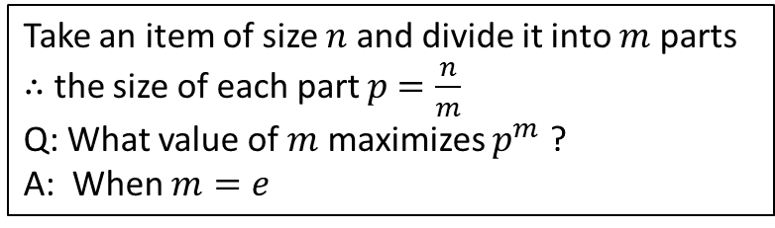

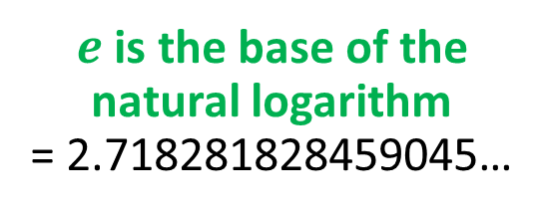
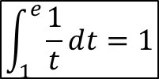
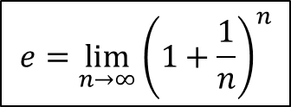
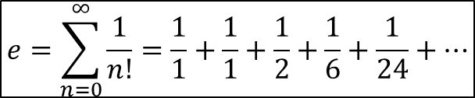

Why is $e$ so special?
Take an item of size $n$ and divide it into $m$ parts
$∴$ the size of each part $p$ $=\frac{n}{m}$
Q: What value of $m$ maximizes $p^{m}$ ?
A: When $m=e$
$$e=\sum_{n=0}^{∞}{\frac{1}{n!}=\frac{1}{1}+\frac{1}{1}+\frac{1}{2}+\frac{1}{6}+\frac{1}{24}+…}$$
$$\int_{1}^{e}{\frac{1}{t}ⅆt=1}$$
$$e=\lim_{n→∞}{{\left(1+\frac{1}{n}\right)}^{n}}$$
$e$ is the base of the natural logarithm
= 2.718281828459045…
$$\ln{e}=1$$

Slide 12
Why is $e$ so special?
$c≡$ a constant
$${ce}^{x}=c+cx+\frac{cx^{2}}{2!}+\frac{cx^{3}}{3!}+\frac{cx^{4}}{4!}+\frac{cx^{5}}{5!}+\frac{cx^{6}}{6!}+\frac{cx^{7}}{7!}+…$$
$\frac{d}{dx}\left(ce^{x}\right)=\frac{d}{dx}\left(c\right)+\frac{d}{dx}\left(cx\right)+\frac{d}{dx}\left(\frac{{cx}^{2}}{2!}\right)+\frac{d}{dx}\left(\frac{{cx}^{3}}{3!}\right)+…$
$$\frac{d}{dx}\left({ce}^{x}\right)=0+c+cx+\frac{cx^{2}}{2!}+\frac{x^{3}}{3!}+\frac{x^{4}}{4!}+\frac{x^{5}}{5!}+\frac{x^{6}}{6!}+\frac{x^{7}}{7!}+…$$
$$\frac{d}{dx}\left(ce^{x}\right)={ce}^{x}$$
${ce}^{x}$is the only function which is the derivative of itself !

Slide 13
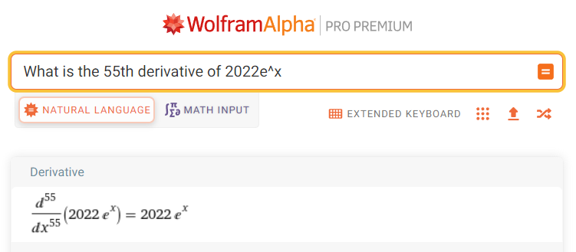
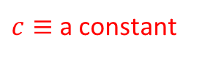
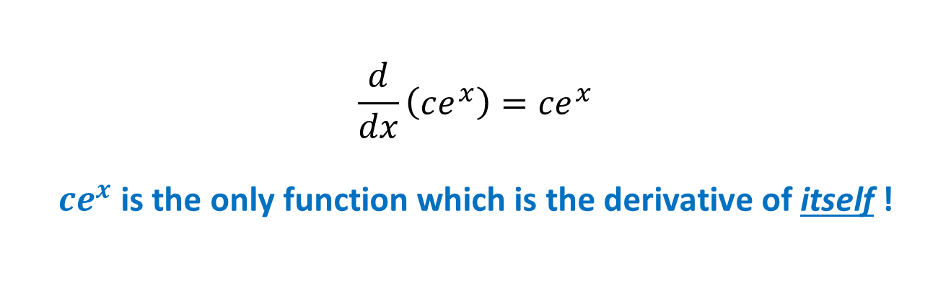
Why is $e$ so special?
$c≡$ a constant
$$\frac{d}{dx}\left(ce^{x}\right)={ce}^{x}$$
${ce}^{x}$is the only function which is the derivative of itself !

Slide 14
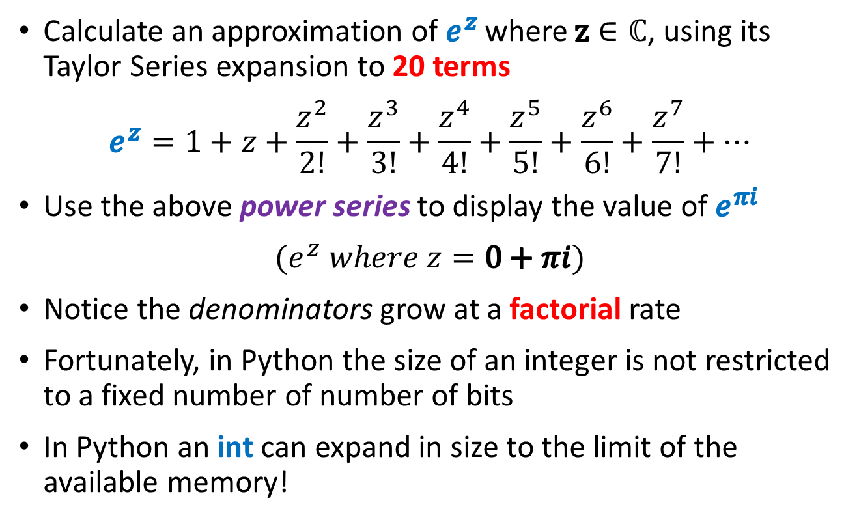
Euler’s Identity
Calculate an approximation of $e^{z}$ where $z∈ℂ$, using its Taylor Series expansion to 20 terms
$$e^{z}=1+z+\frac{z^{2}}{2!}+\frac{z^{3}}{3!}+\frac{z^{4}}{4!}+\frac{z^{5}}{5!}+\frac{z^{6}}{6!}+\frac{z^{7}}{7!}+…$$
Use the above power series to display the value of $e^{πi}$
$$(e^{z} where z=0+πi)$$
Notice the denominators grow at a factorial rate
Fortunately, in Python the size of an integer is not restricted to a fixed number of number of bits
In Python an int can expand in size to the limit of the available memory!

Slide 15
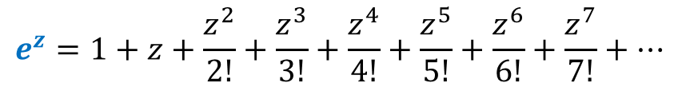
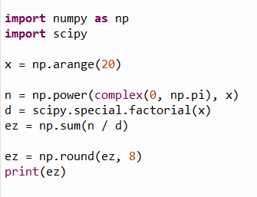
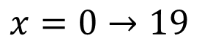
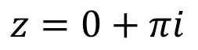
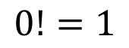
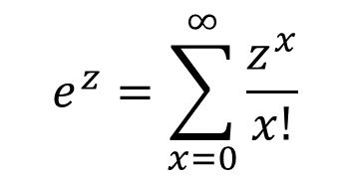
Edit euler_identity.py
$$x=0→19$$
$$z=0+πi$$
①
②
$$e^{z}=\sum_{x=0}^{∞}{\frac{z^{x}}{x!}}$$
③
④
⑤
⑥
$$0!=1$$
x is an array of the integer exponents
n is an array of the numerators
d is an array of the denominators

Slide 16
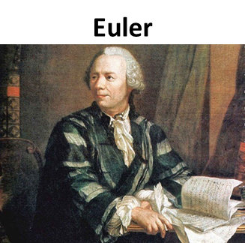
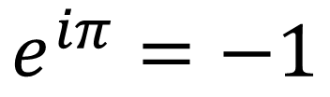
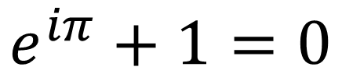
Run euler_identity.py
$$e^{iπ}=−1$$
$$e^{iπ}+1=0$$

Slide 17
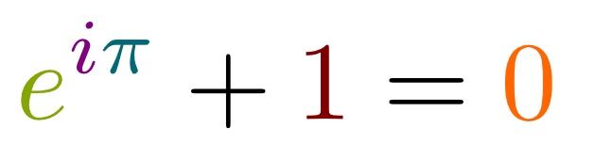
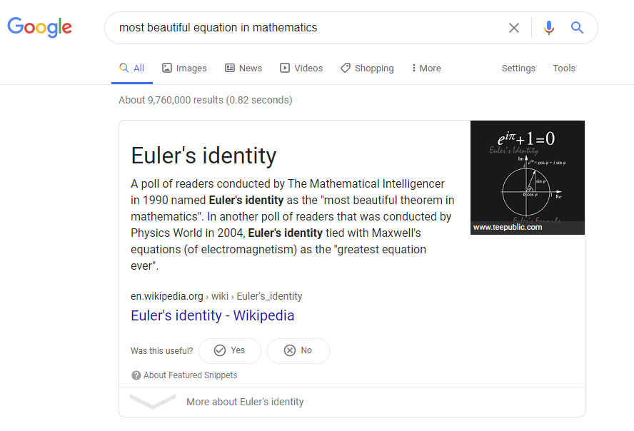
Euler’s Identity

Slide 18
$$−1=e^{πi}$$
$$i^{i}= ?$$
$${\left(−1\right)}^{\frac{1}{2}}={\left(e^{πi}\right)}^{\frac{1}{2}}$$
$$\sqrt{−1}=e^{\frac{πi}{2}}$$
$${\left(a^{b}\right)}^{c}=a^{bc}$$
$${\left(2^{3}\right)}^{4}=2^{3×4}=2^{12}$$
$$i=e^{\frac{πi}{2}}$$
$$i^{i}={\left(e^{\frac{πi}{2}}\right)}^{i}$$
$$e^{πi}=−1$$
$$i^{i}=e^{\frac{πi^{2}}{2}}$$
$$i^{i}=e^{\frac{−π}{2}}$$
$i^{i}≅0.20787∈ℝ$

Slide 19




Euler’s Formula
Img
Use the chain rule!
$$z=\cos{θ}+i\sin{θ}$$
$$\frac{d}{dθ}\left(e^{iθ}\right)=ie^{iθ}$$
1
Argand Form of a Unit Complex Number
$$z=e^{iθ}$$
$$i^{2}=−1$$
$$\sin{θ}$$
$$\frac{d^{2}}{dθ^{2}}\left(e^{iθ}\right)=−e^{iθ}$$
$$θ$$
Re
$$\cos{θ}$$
Exponential Form of a Unit Complex Number
$$e^{iθ}=\cos{θ}+i\sin{θ}$$
Euler’s Formula
$$\frac{dz}{dθ}=−\sin{θ+i\cos{θ}}$$
$$\frac{d^{2}z}{dθ^{2}}=−\cos{θ−i\sin{θ}}$$
$$\frac{dz}{dθ}=i\left(\cos{θ}+i\sin{θ}\right)=iz$$
$$\frac{d^{2}z}{dθ^{2}}=i^{2}\left(\cos{θ}+i\sin{θ}\right)=i^{2}z=−z$$

Slide 20
Euler's Formula
$$\cos{x}=1−\frac{x^{2}}{2!}+\frac{x^{4}}{4!}−\frac{x^{6}}{6!}+\frac{x^{8}}{8!}+…$$
$$\sin{x}=x−\frac{x^{3}}{3!}+\frac{x^{5}}{5!}−\frac{x^{7}}{7!}+\frac{x^{9}}{9!}+…$$
$$e^{x}=1+x+\frac{x^{2}}{2!}+\frac{x^{3}}{3!}+\frac{x^{4}}{4!}+\frac{x^{5}}{5!}+\frac{x^{6}}{6!}+\frac{x^{7}}{7!}…$$
$$e^{ix}=1+ix+\frac{{\left(ix\right)}^{2}}{2!}+\frac{{\left(ix\right)}^{3}}{3!}+\frac{{\left(ix\right)}^{4}}{4!}+\frac{{\left(ix\right)}^{5}}{5!}+\frac{{\left(ix\right)}^{6}}{6!}+\frac{{\left(ix\right)}^{7}}{7!}+…$$
$$e^{ix}=1+ix−\frac{x^{2}}{2!}−i\frac{x^{3}}{3!}+\frac{x^{4}}{4!}+i\frac{x^{5}}{5!}−\frac{x^{6}}{6!}−i\frac{x^{7}}{7!}+……$$
$$e^{ix}=\left(1−\frac{x^{2}}{2!}+\frac{x^{4}}{4!}−\frac{x^{6}}{6!}\right)+i\left(x−\frac{x^{3}}{3!}+\frac{x^{5}}{5!}−\frac{x^{7}}{7!}\right)+…$$
$$e^{ix}=\cos{x}+i\sin{x}$$
☑

Slide 21

Euler’s Formula
The difference between $e^{x}$ and $e^{ix}$
Complex exponentials wave!
$$\cos{θ}$$
$$\sin{θ}$$

Slide 22



Rosalind Franklin – Helical Structure of DNA
Complex exponentials wave!

Slide 23

Open euler_formula.py
①
②
③
④
⑤
⑥
⑦
⑧

Slide 24



View euler_formula.py
①
$$y=e^{x}$$
②
③
④
$$y=e^{ix}$$
⑤
Both plots will have the same domain
⑥
⑦
⑧
⑨

Slide 25

View euler_formula.py
①
Convert complex exponential to Argand coordinates
②
③
④
⑤
⑥
⑦
⑧

Slide 26

View euler_formula.py
①
Convert Argand coordinates to complex exponential
②
③
④
⑤
⑥
⑦
⑧
⑨

Slide 27




Run euler_formula.py
$$−10≤x≤10$$
$$−10≤θ≤10$$
$e^{x}$ is just a limitless rising curve
$e^{iθ}$ keeps looping, forever locked in a unit circle

Slide 28
Run euler_formula.py
Point 1
Complex Exponential to
Argand Coordinates
$$−10≤x≤10$$
$$θ$$
$$\sqrt{{\left(−1\right)}^{2}+{\left(−1.5\right)}^{2}}=\sqrt{3.25}=1.803$$
$$θ=2\tan^{−1}\left(\frac{−1.5}{−1+\sqrt{3.25}}\right)=−2.159$$
Point 2
Argand Coordinates to
Complex Exponential

Slide 29






Euler’s Formula
$$e^{iθ}=\cos{θ}+i\sin{θ}$$
$$e^{iθ}=\cos{θ}+i\sin{θ}$$
$$+$$
$$−$$
$$e^{−iθ}=\cos{θ}−i\sin{θ}$$
$$e^{−iθ}=\cos{θ}−i\sin{θ}$$
$$e^{iθ}+e^{−iθ}=2cos{θ}$$
$$e^{iθ}−e^{−iθ}=2i\sin{θ}$$
$$\cos{θ}=\frac{e^{iθ}+e^{−iθ}}{2}$$
$$\sin{θ}=\frac{e^{iθ}−e^{−iθ}}{2i}$$
$$θ=0→\frac{1+1}{2}$$
$$θ=0→\frac{1−1}{2}$$
$$\cos{0=1} in ℝ$$
$$\sin{0}=0 in ℝ$$

Slide 30
$$\sqrt{i}+\sqrt{−i}= ?$$
$$e^{iθ}=\cos{θ+i\sin{θ}}$$
$$\left(\cos{\frac{π}{4}+i\sin{\frac{π}{4}}}\right)+\left(\cos{\frac{−π}{4}+i\sin{\frac{−π}{4}}}\right)$$
$$e^{\frac{π}{2}i}=i$$
$$e^{\frac{−π}{2}i}=−i$$
$$\left(\frac{1}{\sqrt{2}}+\frac{i}{\sqrt{2}}\right)+\left(\frac{1}{\sqrt{2}}+\frac{−i}{\sqrt{2}}\right)$$
$$\sqrt{e^{\frac{π}{2}i}}+\sqrt{e^{\frac{−π}{2}i}}$$
$$\frac{1}{\sqrt{2}}+\frac{1}{\sqrt{2}}=\frac{2}{\sqrt{2}}=\sqrt{2}$$
$${\left(e^{\frac{π}{2}i}\right)}^{\frac{1}{2}}+{\left(e^{\frac{−π}{2}i}\right)}^{\frac{1}{2}}$$
$$\sqrt{i}+\sqrt{−i}=\sqrt{2}$$
$e^{\frac{π}{4}i}+$ $e^{\frac{−π}{4}i}$

Slide 31

Complex Algebra
Only the set of complex numbers $ℂ$ is closed under both division and radicals
$$\frac{1}{2}∉ℤ, \sqrt{2}∉ℚ, \sqrt{−1}∉ℝ$$
The numerators in the Taylor series for $e^{x}$ can be complex numbers
Euler’s Identity shows a deep relationship between the five most important constants in all of Mathematics!

Slide 32

Complex Algebra
Euler’s Formula is considered the most useful equation in all of mathematics!
$$e^{iθ}=\cos{θ+i\sin{θ}}$$
Napier’s logarithm down converts multiplication into easier addition:
$$\log{AB=\log{A}+\log{B}}$$
De Moivre’s Formula down converts exponentiation into easier multiplication:
$${\left(\cos{θ+i\sin{θ}}\right)}^{n}=\cos{nθ+i\sin{nθ}}$$
Euler's Formula is a crucial element of Fourier Analysis, and hence a foundational concept in Quantum Mechanics

Slide 33
Topic 01 – Goals – Part 2 of 2
Perform Fourier Analysis using the Discrete Fourier Transform (DFT)
Perform Fourier Synthesis using the Inverse Discrete Fourier Transform (IDFT)
Investigate radio transmissions received from deep space
Determine the fundamental frequency of Sunspot Activity
Use the DFT to remove high-frequency interference
Consider the DFT of a square wave
Consider the DFT of a damped oscillator

Slide 34
Superposition $⇒$ Perceived Complexity
What appears to be a complicated waveform might be just a series of simple waves all added together (in a linear superposition)
Underneath the perceived random behavior of a function undergoing wild fluctuations might be a system of straightforward waves
These simple waves may individually convey some important knowledge about the true nature of the observed complexity
The process of determining the underlying simple waveforms that make up a complicated wave is called Fourier Analysis

Slide 35




Superposition $⇒$ Perceived Complexity
Wave #1
Wave #3
Wave #2
Wave #4

Slide 36


Superposition $⇒$ Perceived Complexity
Wave #1
Wave #1 & #2
Wave #1 + #2
Wave #2

Slide 37



Superposition $⇒$ Perceived Complexity
Wave #3
Wave #3 & #4
Wave #3 + #4
Wave #4

Slide 38

Superposition $⇒$ Perceived Complexity
Waves #1 & #2 & #3 & #4

Slide 39

Superposition $⇒$ Perceived Complexity
Waves #1 + #2 + #3 + #4

Slide 40


Fourier Transform
Continuous and Discrete
Jean-Baptiste Fourier (1768-1830)
both r’s are silent
“Foo-yay”

Slide 41
Fourier Analysis
Converting a complicated wave into a sum of simple waves having potentially non-integer amplitudes but integer frequencies is called the Fourier Transform
The reverse process of reconstructing the original complicated wave by summing all the contributions of the simple waves is called the Inverse Fourier Transform
It is a transform because we are converting back and forth between representing a wave as a sum of amplitudes over time versus a sum of amplitudes over integer frequencies
It is two sides of the same mirror – both approaches equally describe the same wave – but the frequency view often reveals hidden patterns in the wave

Slide 42

Fourier Analysis
$$f\left(t\right)=29\cos\left(3t\right)+17\sin\left(11t\right)+7\cos\left(19t\right)+2\sin\left(31t\right)$$
…how can we determine each "term" (each simple wave) in the superposition?
Given a complicated wave…

Slide 43

Fourier Analysis - Intuition
$$0 ≤t<2π$$
$$f\left(t\right)=\sin\left(t\right)$$
$$\int_{0}^{2π}{\sin\left(t\right) dt=0}$$

Slide 44

Fourier Analysis - Intuition
$$0 ≤t<2π$$
$$f\left(t\right)=\sin\left(t\right)\sin\left(t\right)$$
$$\int_{0}^{2π}{\sin\left(t\right)\sin{(t)}dt=π}$$

Slide 45

Fourier Analysis - Intuition
$$0 ≤t<2π$$
$$f\left(t\right)=\sin\left(2t\right)$$
$$\int_{0}^{2π}{\sin\left(2t\right) dt=0}$$

Slide 46

Fourier Analysis - Intuition
$$0 ≤t<2π$$
$$f\left(t\right)=\sin\left(2t\right)\sin\left(2t\right)$$
$$\int_{0}^{2π}{\sin\left(2t\right)\sin{(2t)}dt=π}$$

Slide 47

Fourier Analysis - Intuition
$$0 ≤t<2π$$
$$f\left(t\right)=\sin\left(t\right)\sin\left(2t\right)$$
$$\int_{0}^{2π}{\sin\left(t\right)\sin{(2t)}dt=0}$$

Slide 48

Fourier Analysis - Intuition
$$0 ≤t<2π$$
$$f\left(t\right)=\cos\left(t\right)\sin\left(t\right)$$
$$\int_{0}^{2π}{\cos\left(t\right){\sin{(t)}dt}=0}$$

Slide 49

Fourier Analysis - Intuition
$$0 ≤t<2π$$
$$f\left(t\right)=\cos\left(t\right)\sin\left(2t\right)$$
$$\int_{0}^{2π}{\cos\left(t\right){\sin{(2t)}dt}=0}$$

Slide 50
Fourier Analysis - Intuition
Complicated Wave
Filter Wave
$$\int_{0}^{2π}{\sin{(nt)\sin\left(kt\right)dt}}$$
$$=π when k=n$$
$$=0 when k≠n$$
The only time the integral of the product of two sinusoids is > 0 is when both waves have matching frequency and phase
$$\int_{0}^{2π}{\cos{(nt)\cos\left(kt\right)dt}}$$
$$=π when k=n$$
$$=0 when k≠n$$
$$\int_{0}^{2π}{\cos{(nt)\sin\left(kt\right)dt}}$$
$$=0 when k=n$$
$$=0 when k≠n$$
Only the simple "filter" (k) waves (each having an increasing integer frequency)
when multiplied against the "complicated" (n) wave, that yield a non-zero integral, can possibly be components of the original wave

Slide 51
Fourier Analysis
Complicated Wave
Filter Wave
$$\int_{0}^{2π}{f\left(t\right)h\left(t\right)dt}=\int_{0}^{2π}{\left[29\cos\left(3t\right)+17\sin\left(11t\right)+7\cos\left(19t\right)+2\sin\left(31t\right)\right]h\left(t\right)dt}$$
$$\cos\left(1t\right)$$
$$29\cos\left(3t\right)+$$
$$\sin\left(1t\right)$$
$$29\cos\left(3t\right)+$$
$$\sin\left(11t\right)$$
$$29\cos\left(3t\right)+$$
$$\cos\left(1t\right)$$
$$17\sin\left(11t\right)+$$
$$\sin\left(1t\right)$$
$$17\sin\left(11t\right)+$$
$$\sin\left(11t\right)$$
$$17\sin\left(11t\right)+$$
$$\cos\left(1t\right)$$
$$7\cos\left(19t\right)+$$
$$\sin\left(1t\right)$$
$$7\cos\left(19t\right)+$$
$$\sin\left(11t\right)$$
$$7\cos\left(19t\right)+$$
$$\cos\left(1t\right)$$
$$2\sin\left(31t\right)+$$
$$\sin\left(1t\right)$$
$$2\sin\left(31t\right)+$$
$$\sin\left(11t\right)$$
$$2\sin\left(31t\right)+$$
$$\cos\left(2t\right)$$
$$29\cos\left(3t\right)+$$
$$\sin\left(2t\right)$$
$$29\cos\left(3t\right)+$$
$$\cos\left(19t\right)$$
$$29\cos\left(3t\right)+$$
$$\cos\left(2t\right)$$
$$17\sin\left(11t\right)+$$
$$\sin\left(2t\right)$$
$$17\sin\left(11t\right)+$$
$$\cos\left(19t\right)$$
$$17\sin\left(11t\right)+$$
$$\cos\left(2t\right)$$
$$7\cos\left(19t\right)+$$
$$\sin\left(2t\right)$$
$$7\cos\left(19t\right)+$$
$$\cos\left(19t\right)$$
$$7\cos\left(19t\right)+$$
$$\cos\left(2t\right)$$
$$2\sin\left(31t\right)+$$
$$\sin\left(2t\right)$$
$$2\sin\left(31t\right)+$$
$$\cos\left(19t\right)$$
$$2\sin\left(31t\right)+$$
$$\cos\left(3t\right)$$
$$29\cos\left(3t\right)+$$
$$\sin\left(3t\right)$$
$$29\cos\left(3t\right)+$$
$$\sin\left(31t\right)$$
$$29\cos\left(3t\right)+$$
$$\cos\left(3t\right)$$
$$17\sin\left(11t\right)+$$
$$\sin\left(3t\right)$$
$$17\sin\left(11t\right)+$$
$$\sin\left(31t\right)$$
$$17\sin\left(11t\right)+$$
$$\cos\left(3t\right)$$
$$7\cos\left(19t\right)+$$
$$\sin\left(3t\right)$$
$$7\cos\left(19t\right)+$$
$$\sin\left(31t\right)$$
$$7\cos\left(19t\right)+$$
$$\cos\left(3t\right)$$
$$2\sin\left(31t\right)+$$
$$\sin\left(3t\right)$$
$$2\sin\left(31t\right)+$$
$$\sin\left(31t\right)$$
$$2\sin\left(31t\right)+$$

Slide 52
Fourier Analysis
$$f\left(t\right)=29\cos\left(3t\right)+17\sin\left(11t\right)+7\cos\left(19t\right)+2\sin\left(31t\right)$$
But how do we determine the amplitudes of the simple waves?
$$\int_{0}^{2π}{f\left(t\right)ⅆt}=\int_{0}^{2π}{\left(A_{3}\cos\left(3t\right)+B_{11}\sin\left(11t\right)+A_{19}\cos\left(19t\right)+B_{31}\sin\left(31t\right)\right)}ⅆt$$
Integral of Sum = Sum of Integrals
(Amplitudes are constant and move outside the Integral)
Filter Wave
$$\int_{0}^{2π}{\cos\left(3t\right)f\left(t\right)ⅆt}=A_{3}\int_{0}^{2π}{\cos\left(3t\right)\cos\left(3t\right)}ⅆt+0+0+0$$
$$\int_{0}^{2π}{\cos\left(3t\right)f\left(t\right)ⅆt}=A_{3}\left(π\right)$$
See slide #19

Slide 53
Fourier Analysis
$$f\left(t\right)=29\cos\left(3t\right)+17\sin\left(11t\right)+7\cos\left(19t\right)+2\sin\left(31t\right)$$
But how do we determine the amplitudes of the simple waves?
$$\int_{0}^{2π}{f\left(t\right)ⅆt}=\int_{0}^{2π}{\left(A_{3}\cos\left(3t\right)+B_{11}\sin\left(11t\right)+A_{19}\cos\left(19t\right)+B_{31}\sin\left(31t\right)\right)}ⅆt$$
Integral of Sum = Sum of Integrals
(Amplitudes are constant and move outside the Integral)
Filter Wave
$$\int_{0}^{2π}{\sin\left(11t\right)f\left(t\right)ⅆt}=0+B_{11}\int_{0}^{2π}{\sin\left(11t\right)sin\left(11t\right)}ⅆt+0+0$$
$$\int_{0}^{2π}{\cos\left(3t\right)f\left(t\right)ⅆt}=A_{3}\left(π\right)$$
$$\int_{0}^{2π}{\sin\left(11t\right)f\left(t\right)ⅆt}=B_{11}\left(π\right)$$
See slide #19
$$\int_{0}^{2π}{\cos\left(19t\right)f\left(t\right)ⅆt}=A_{19}\left(π\right)$$
$$\int_{0}^{2π}{\sin\left(31t\right)f\left(t\right)ⅆt}=B_{31}\left(π\right)$$

Slide 54
Discrete Fourier Analysis
Converting a sampled complicated wave into a series of simple waves, each with amplitudes at specific integer frequencies, is called the Discrete Fourier Transform (DFT)
The reverse process of reconstructing the original complex wave by summing all the contributing simple waveforms is called the Inverse Discrete Fourier Transform (IDFT)
The sum of many discrete samples of a wave approximates its continuous integral if the spacing (time) between samples is sufficiently small – this is analogous to taking a Riemann sum as the width of each rectangular area strip approaches zero

Slide 55

Discrete Fourier Analysis
There is no obvious pattern within the complicated waveform
We scale the domain values to span $[0,\frac{2}{N}π]$
$$0$$
$$2π$$

Slide 56

Discrete Fourier Analysis
$$0$$
$$\left(\sum{f\left(t_{0}\right)+f\left(t_{1}\right)+⋯+f\left(t_{N−1}\right)}\right)$$
$$2π$$
$$\int_{a}^{b}{f\left(t\right)ⅆt}=\lim_{n→∞}{\sum_{s=0}^{n−1}{f\left(t_{s}\right)∙Δt}}$$
$$Δt$$
$$Δt=\frac{b−a}{n}$$
$$f\left(t_{s}\right)$$
$$a=0,b=2π→Δt=\frac{2π}{N}$$
$$\int{=\frac{2π}{N}\left(\sum{ }\right)}$$
$$\int{=A_{k}π}$$
$$A_{k}π=\frac{2π}{N}\left(\sum{ }\right)$$
$N=$ the number of samples
Same formula for $B_{k}$
$$A_{k}=\frac{2}{N}\sum{f\left(t_{s}\right)}$$

Slide 57
Discrete Fourier Analysis
Filter Wave
Complicated Wave
The integral of any cosine wave from $0$ to $2π$ equals zero
0
1
$$\int_{0}^{2π}{\cos\left(0t\right)\left[A\cos\left(nt\right)+f_{0}\right]ⅆt}$$
$$=\left[\int_{0}^{2π}{A\cos\left(nt\right)ⅆt}\right]+\left[f_{0}\int_{0}^{2π}{ⅆt}\right]=2πf_{0}$$
Filter Wave
Number
Offset
Filter Wave
Number
$$k>0→\int{=A_{k}π}$$
$$k=0→\int{=2πf_{0}}$$
$$A_{k}=\frac{2}{n}\sum{f\left(t_{s}\right)}$$
$$2πf_{0}=\frac{2π}{n}\left(\sum{ }\right)$$
See prior slide
The first DFT term $A_{0}$ should not be multiplied by 2 while all later terms $A_{n}$ must be multiplied by 2
$$f_{0}=\frac{1}{n}\sum{f\left(t_{s}\right)}$$
$f_{0}$ = Offset = DC Value

Slide 58
Discrete Fourier Transform (DFT)
$N$ is the number of samples
$$f\left(t_{s}\right)≈\sum_{n=0}^{N−1}{\left[A_{n}\cos\left(nt_{s}\right)+B_{n}\sin\left(nt_{s}\right)\right]}$$
$t_{s}=$ time of sample
Euler’s Formula
DFT (complex)
$e^{i(k⋅t_{s}\left[n\right])}$ is the $k^{th}$ filter wave
$$F\left[k\right]=\frac{2}{N}\sum_{n=0}^{N−1}{f\left[n\right]e^{i\left(k{⋅t}_{s}\left[n\right]\right)}}$$
$$e^{iθ}=\cos{θ}+i\sin{θ}$$
$f\left[n\right]$ are the real-valued sampled wave amplitudes
$$\cos{θ}=\frac{e^{iθ}+e^{−iθ}}{2}$$
Inverse DFT (complex)
$F\left[n\right]$ are the complex amplitudes for each filter wave number $k$
$$\sin{θ}=\frac{e^{iθ}−e^{−iθ}}{2i}$$
$$f\left[n\right]=\sum_{n=0}^{N−1}{F\left[k\right]e^{−i\left(k⋅t_{s}\left[n\right]\right)}}$$

Slide 59

Open make_samples.py
$$f\left(t\right)=29\cos\left(3t\right)+17\sin\left(11t\right)+7\cos\left(19t\right)+2\sin\left(31t\right)$$
We are generally not privy to the underlying formula that generated the measured (complicated) wave
①

Slide 60

View make_samples.py
①
②
Avoid duplicate endpoints
③
④
⑤
⑥
2 rows x 1000 columns
1000 rows x 2 columns
⑦

Slide 61
Run make_samples.py
There is no obvious pattern within the complicated waveform
We scale the domain values to span $[0,\frac{2}{N}π]$
$$0$$
$$2π$$

Slide 62

Open samples.csv
$$t_{s}=sample time$$
$$f_{s}=sample value$$
The program generated this “comma separated value” (CSV) text file that contains the sampled sinusoid data points

Slide 63
Discrete Fourier Analysis
We now wish to analyze the sample data through the lens of Fourier Analysis
We know that Mother Nature often shows us only her complicated side, and our job as scientists is to unravel those mysteries – to get to the simplicity and beauty hiding behind that complexity
Often the true nature of the underlying physical laws generating the measured data can be better understood by identifying the simple waves that (when in superposition) appear to be a complicated signal
Fourier Analysis is the microscope of scientific computing – it is one of the most powerful methods we have in our toolbox

Slide 64

Open fourier_discrete.py
②
③
④
⑤
⑥
⑦
⑧
⑨
⑩
①

Slide 65


View fourier_discrete.py
①
②
③
④
⑤
⑥
⑦
⑧
See slide #57

Slide 66

View fourier_discrete.py
①
②
③
④
⑤
⑥

Slide 67

View fourier_discrete.py
①
②
③
④

Slide 68

Run fourier_discrete.py

Slide 69

Unravelling the Complicated Wave
$$f\left(t\right)=29\cos\left(3t\right)+17\sin\left(11t\right)+7\cos\left(19t\right)+2\sin\left(31t\right)$$

Slide 70

Reconstructing the Complicated Wave
The Inverse DFT was able to identically reconstruct the original complicated wave by summing together only four simple waves

Slide 71

Information Density
$$f\left(t\right)=29\cos\left(3t\right)+17\sin\left(11t\right)+7\cos\left(19t\right)+2\sin\left(31t\right)$$
Time domain
Frequency domain
1000 time values
1000 amplitude values
4 frequency values
4 amplitude values
All the complexity of the original waveform
in the time domain (2000 numbers) is fully described using just eight numbers in the frequency domain!

Slide 72

Every JPEG Image uses the DFT

Slide 73

All Streaming Video Services use the DFT
June 2013
May 2003

Slide 74

All Streaming Video Services use the DFT
4K / 8K Video
March 2018
June 2013
May 2003

Slide 75

The Most Important Algorithm Ever Invented
The FFT can easily perform a DFT one billion times faster than our naïve approach!
https://www.youtube.com/watch?v=h7apO7q16V0

Slide 76



The Most Important Algorithm Ever Invented
1965
①

Slide 77


Open fft.py
①
②
③

Slide 78

View fft.py
①

Slide 79

Run fft.py (samples.csv)

Slide 80

Check fourier_discrete.py (samples.csv)
We obtain the same DFT using our naïve approach or the FFT, but the FFT is significantly faster!

Slide 81


Analysis of Space Signals
Mojave Desert in California
The NASA 70m Antenna has detected three candidate signals originating from deep space
Your task is to perform Fourier Analysis on each signal to determine which one is more likely to have been a broadcast from an extraterrestrial intelligence

Slide 82

Space Signal # 1

Slide 83

Space Signal # 2

Slide 84

Space Signal # 3

Slide 85

Edit fft.py
①

Slide 86

Run fft.py – space_signal1.csv

Slide 87

Edit fft.py
①

Slide 88

Run fft.py – space_signal2.csv

Slide 89

Edit fft.py
①

Slide 90

Run fft.py – space_signal3.csv

Slide 91

Analysis of Space Signals
Mojave Desert in California
The NASA 70m Antenna has detected three candidate signals originating from deep space
Your task is to perform Fourier Analysis on each signal to determine which one is more likely to have been a broadcast from an extraterrestrial intelligence

Slide 92

space_signal1.csv
The cosine and sine waves alternate, demonstrating on/off (Boolean) logic
The amplitudes are the squares of the first four prime numbers $\left(2^{2}, 3^{2},5^{2},7^{2}\right)$
The frequencies $\left(1,6,7,8\right)$ match the number of protons in Hydrogen(1), Carbon(6), Nitrogen(7), and Oxygen(8) : the most prevalent atoms in organic chemistry
It is very unlikely this signal could have been constructed by some random process

Slide 93
Who could see that this signal carries so much embedded intelligence?
Space Signal # 1

Slide 94

Sunspot Activity

Slide 95

Sunspot Activity

Slide 96



Sunspot Activity
https://www.sidc.be/SILSO/datafiles
Humans have counted sunspots every day
from 1700!

Slide 97
Power Spectrum
The green “Power Spectrum” graph shows the magnitude (modulus) of the complex terms representing the amplitudes of every frequency present in the original signal
High peaks in a power spectrum indicate the significant (dominant) frequencies in the original complicated waveform
Can we use the power spectrum graph to determine the main underlying period of the recurring sunspot cycles?

Slide 98

Edit fft.py
①

Slide 99


Run fft.py – sunspots.csv (circa 2016)
Which is the dominant frequency (29 or 30)?
There is an unexplained ~11-year cycle in sunspot activity!

Slide 100

Creating a High Frequency Filter
High frequency interference is distorting the capture of what we believe to be a stable (clean) primary signal
We want to remove this high frequency jitter (interference) before using the inverse discrete Fourier transform (IDFT) so we can reconstruct the original undistorted signal

Slide 101

Creating a High Frequency Filter
The DFT identifies the constituent simple waves which compose a complicated wave
This interference could be filtered by eliminating the simple waves that have a high frequency
This is the primary signal
This is the interference

Slide 102

Open fourier_filter.py
①
$$f\left(t\right)=29\cos\left(3t\right)+7\sin\left(40t\right)$$
②
③
④

Slide 103

Run fourier_filter.py
We can zero out the amplitude of the high frequency component of the sampled wave
We want to remove this high-frequency noise (wiggle)

Slide 104

Edit fourier_filter.py

Slide 105

Run fourier_filter.py
The original pure signal has been faithfully isolated

Slide 106

Fourier Analysis of Square Waves
The data file samples_square.csv contains captured waveform data of a signal having amplitude = 1 over the interval $π−\frac{π}{2}≤t≤π+\frac{π}{2}$and a zero amplitude elsewhere
Edit fft.py to analyze this data file (see the next slide)
Then consider these three questions:
Why does the power spectrum of the sampled waveform have so many frequencies?
Why does the magnitude of the DC component $=1/2$ ?
Why are there no sine components in its DFT?

Slide 107

Edit fft.py
①

Slide 108







$$\frac{π}{2}$$
$$π$$
$$\frac{π}{2}$$
Only 50% of the sample time does $f\left(x\right)=1$
$$π−\frac{π}{2}$$
$$π+\frac{π}{2}$$
Cosine is an EVEN function -
symmetric around its midpoint
Sine is an ODD function -antisymmetric around its midpoint
Discontinuous jumps can be approximated only by an infinite sum of sinusoids

Slide 109


Slide 110
The Limits of Fourier Analysis
In the first lab, the amplitudes of each of the constituent simple waves were constant throughout the sample period
Consider a sinusoid where the amplitudes are changing over the sample period, such as with a damped oscillator
$$f\left(t\right)=13e^{−t}\left[17\cos\left(3t\right)+7\sin\left(23t\right)\right]$$
What do you think the DFT will reveal?
Can we determine the decay factor from the DFT?
$$f\left(t\right)=29\cos\left(3t\right)+17\sin\left(11t\right)+7\cos\left(19t\right)+2\sin\left(31t\right)$$

Slide 111

The DFT of Damped Oscillators
This is a complicated sinusoid where the amplitude is also decaying exponentially

Slide 112

Edit fft.py
①

Slide 113

Run fft.py – samples_decay.csv
$$f\left(t\right)=13e^{−t}\left[17\cos\left(3t\right)+7\sin\left(23t\right)\right]$$

Slide 114
The Limits of Fourier Analysis
$$f\left(t\right)=13e^{−t}\left[17\cos\left(3t\right)+7\sin\left(23t\right)\right]$$
How can we determine these values?

Slide 115



The Laplace Transform is the Generalized Fourier Transform
The Z-transform (the discrete version of the Laplace Transform) can identify the exponential decay factor for damped oscillators
Pierre-Simon Laplace
1749 - 1820

